Slide 1
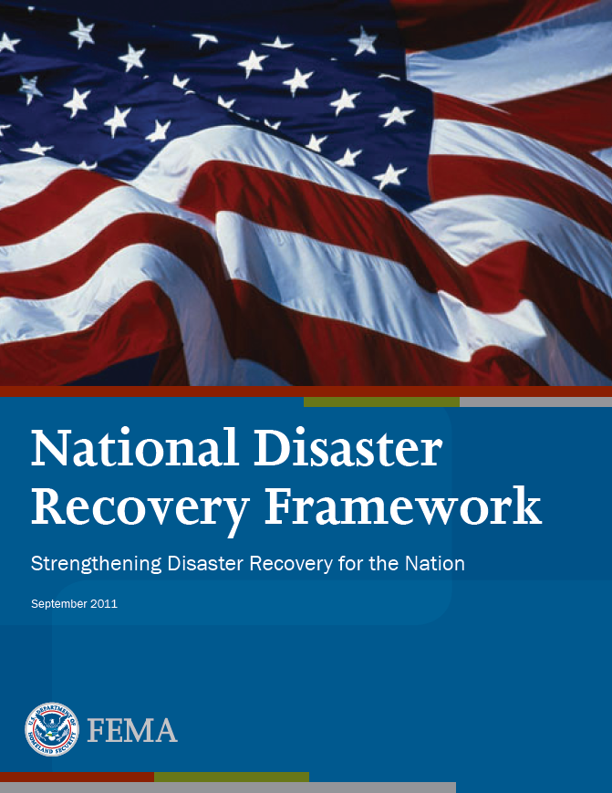
Operationalizing the
National Disaster
Recovery Framework
Michelle Diamond
Community Planning and Capacity Building Coordinator
FEMA Region III

Slide 2
Reasons for establishing the Framework:
Past large-scale recovery efforts had revealed critical challenges - a need for:
Guidance and training
Common doctrine
Established and efficient recovery organizations
Definitions of recovery roles and responsibilities

Slide 3
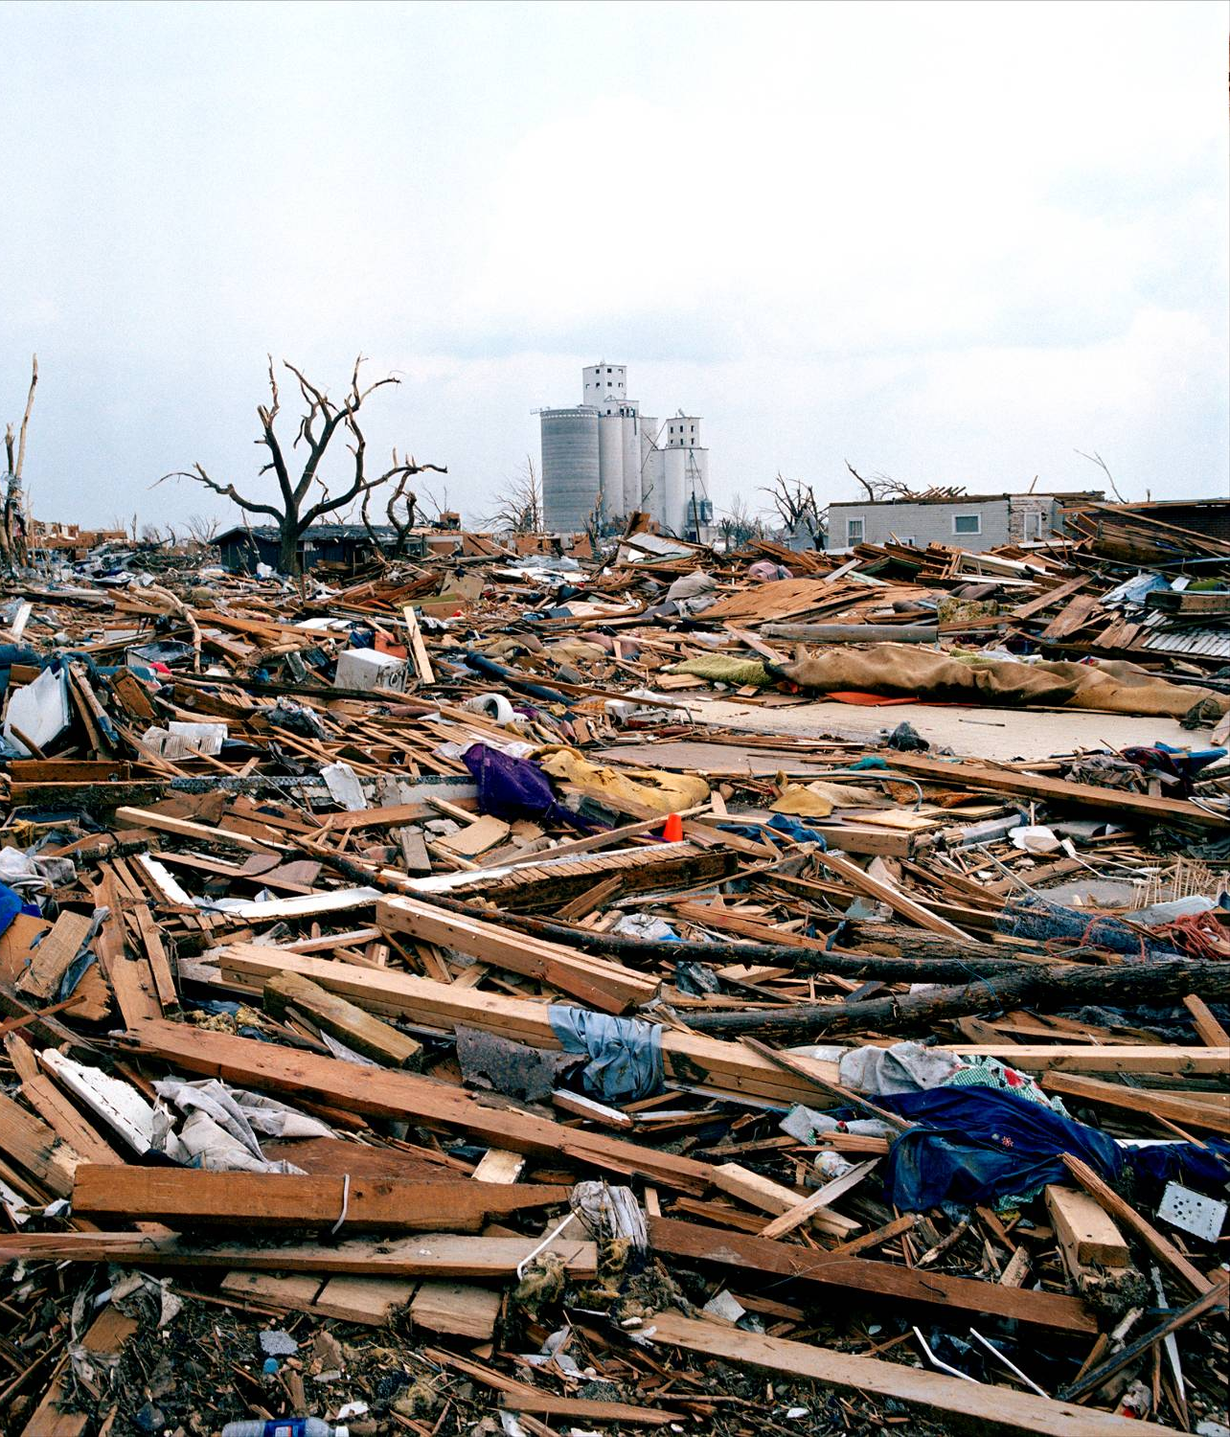
Reasons for establishing the Framework:
Provide a much needed platform to complement the National Response Framework
Respond to the Congressional directive to develop a National Recovery Strategy
Meet the Presidential Policy Directive on National Preparedness (PPD-8), for the development of Frameworks

Slide 4
Whole Community Approach to Emergency Management-
Everyone has a role in response and recovery
Federal, State, Local
Nonprofit, Faith-Based
Business
Citizens
Engage the whole community to determine actual needs
Engage and empower all parts of the community
Strengthen what works well

Slide 5
Major Themes:
Everyone has a role in recovery
Based on Whole Community Approach
Emphasizes Pre- and Post- Recovery Planning
Promotes post-disaster organizations to manage recovery in a deliberate and transparent process
Defines roles and responsibilities
Scalable and flexible

Slide 6
Key Element #1 –
Leadership at every level
Local Disaster Recovery Managers
State/Commonwealth Disaster Recovery Coordinator
Federal Disaster Recovery Coordinator

Slide 7
Key Element #2:
Pre- & Post-Disaster Recovery Planning
Fundamental to the implementation of a well-orchestrated recovery process
Pre-disaster recovery planning enables effective coordination of recovery activities and expedites a unified recovery effort
Post-disaster recovery planning forms the foundation for allocating resources and provides the benchmark for progress

Slide 8
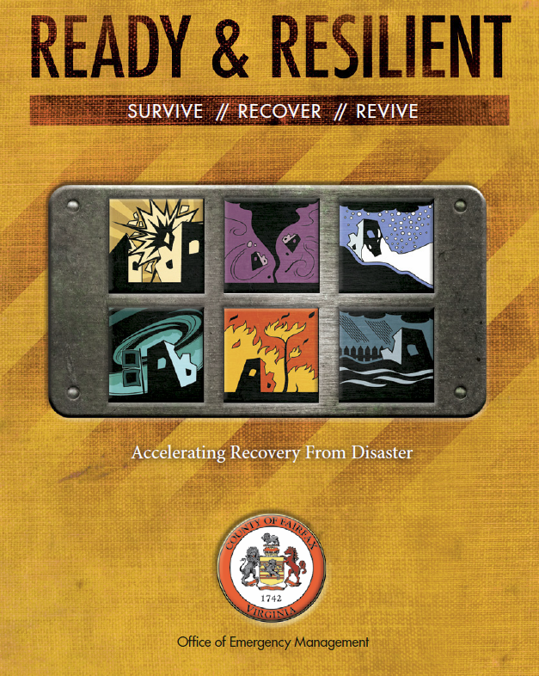
Pre-Disaster Recovery Planning
Establishes process and protocols
Determine leadership
Establish partnerships
Identify limits of capacity and resources
Enhance disaster resilience pre-disaster
Determine recovery process and benchmarks
http://www.fairfaxcounty.gov/oem/pdrp/

Slide 9
Key Element #3:
Recovery Support Functions (RSFs)
RSFs are led by designated Federal coordinating agencies at the national level
Community Planning and Capacity Building (DHS/FEMA)
Economic (Commerce)
Health and Social Services (HHS)
Housing (HUD)
Infrastructure Systems (USACE)
Natural and Cultural Resources (DOI)

Slide 10
ESF-RSF Coordination
ESF #1 - Transportation
ESF #2 - Communications
ESF #3 - Public Works & Engineering
Infrastructure Support
ESF #12 - Energy
ESF #4 - Firefighting
ESF #5 – Emergency Management
Housing Recovery
ESF #6 - Mass Care, Emergency Assistance, Housing, & Human Services
ESF #8 - Public Health & Medical Services
Health & Social Services
ESF #7 – Logistics Management & Resource Support
ESF #9 – Search & Rescue
Natural & Cultural Resources
ESF #10 - Oil & Hazardous Materials Response
ESF #11 - Agriculture & Natural Resources
Economic
ESF #13 – Public Safety & Security
ESF #14 – Long-Term Community Recovery
Community Planning & Capacity Building
ESF #15 – External Affairs
NOTE: ESF #15 - External Affairs will link to all RSFs

Slide 11
RSF Alignment with State Recovery Organizations
Illustrative Example
State Disaster Recovery Coordinator
Federal Disaster Recovery Coordinator
Economic Redevelopment
Economic
Environmental Restoration
Natural & Cultural Resources
Example of how the RSF coordination structure can align with a State recovery organization
Housing/Health & Social Services
Health & Social Services
Infrastructure & Public Facilities
Housing
Financial Administration
Infrastructure Support
Land Use
Community Planning & Capacity Building
Public Outreach

Slide 12
Virginia Recovery Structure
Virginia Department of Emergency Management’s Recovery and Mitigation JFO Standard Operating Guide 2013
Goals include:
Development of State Recovery Framework that interfaces effectively with national and local components
Identifies recovery roles and responsibilities
Operational capability to execute plans
Capability to develop event-specific Recovery Strategy

Slide 13
Virginia Economic Crisis Task Force
Commonwealth Disaster Recovery Coordinator
Secretary Commerce and Trade
Governor
As outlined in JFO SOP:
Governor leads the Virginia’s Recovery Leadership and overall structure
Governor delegates leadership to the Secretary of Commerce and Trade
Designee is responsible for the Economic Crisis Task Force
Responsible for appointing a Commonwealth Disaster Recovery Coordinator (Deputy SCO)

Slide 14
Virginia’s Economic Crisis Strike Force Composition
Community Planning and Capacity Building:
Housing & Community Development
VA Housing Development Authority
Natural & Cultural Resources:
Conservation & Recreation
Environmental Quality
Historic Preservation
Forestry

Slide 15
Virginia’s Economic Crisis Strike Force Composition
Economic:
VA Economic Development Partnership
Agriculture & Consumer Services
Department of Business Assistance
Community College System
Labor and Industry
Minority Business Enterprise
VA Tourism Authority
VA Employment Commission
Housing:
Housing & Community Development
VA Housing Development Authority

Slide 16
Virginia’s Economic Crisis Strike Force Composition
Infrastructure:
Transportation
State Corporation Commission
Conservation & Recreation- Dams
Health- Water Programs
Environmental Quality- Wastewater
Health & Social Services:
Health
Social Services
Education
Medical Assistance Authority

Slide 17
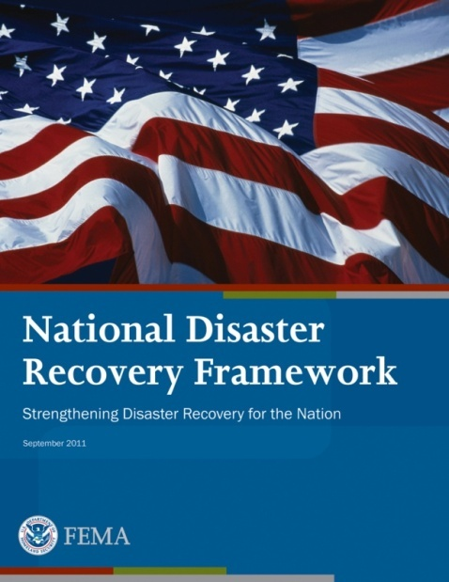
Recovery Federal Interagency Operational Plan
The FIOP provides the concept of operations for integrating and coordinating federal resources.
We will be referring to the FIOP because it is the operational doctrine and centerpiece of how NDRF operations are conducted.
The FIOP includes RSF Annexes written by each of the six RSFs.

Slide 18
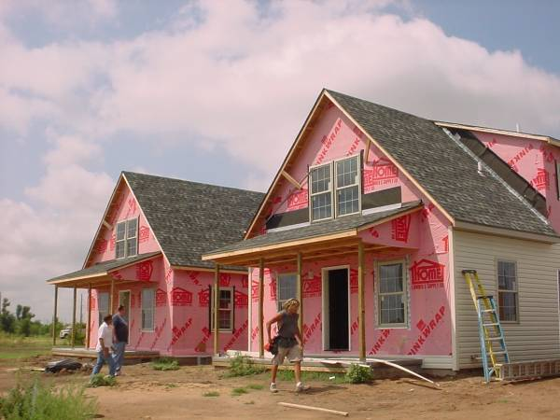
How will the NDRF work in a disaster scenario?
Three Phases of Activation:
Advance Evaluation Team
Mission Scoping Assessment
Recovery Support Strategy

Slide 19
Advanced Evaluation
Overview

Slide 20
FDRC/RSF Activation - Deployment
INITIAL SCOPING OF NEEDS PHASE
5 – 14 days after becoming mission ready
MSA & RSS DEVELOPMENT PHASE
1 – 3 months after determining need for FDRC
IMPLEMENTATION PHASE
3 months to 5 years after completing the RSS
RSF National Coordinators Maintain Situational Awareness of Potential Recovery Concerns
FCO or RA Activates Advance Evaluation Team (AET)
Advance Team Recommend Support
FDRC & RSF support is warranted; FDRC
& relevant RSFs are activated
Yes
No
No FDRC or RSF Recovery Support Warranted
FDRC Activates RSFs
RSFs remotely provide & monitor need for recovery support
No
RSS Update Loop
Yes
RSF Appoints Field Coordinator
Mission Scoping Identifies level of effort necessary to initiate recovery support
Development of Recovery Support Strategy (RSS)
Kickoff & Implement RSS
Track, Monitor & Deliver Assistance
Transition & Return to Steady-State
Mission Scoping Initiated
STATE/TRIBAL/LOCAL COORDINATION & INVOLVEMENT

Slide 21
Advance Evaluation
Advance Evaluation is the process for helping the FCO and Regional Administrator to evaluate the need for an FDRC and RSFs.
The Advance Evaluation Team may be led by the Regional FDRC.
National Disaster Recovery Support Cadre reservists can be called upon to staff the Advance Evaluation Team as needed.

Slide 22
Advanced Evaluation Report
Considerations:
Significant Impacts
Limited Community Capacity
Unique issues and challenges
Extensive damage/Large Scale Disaster
Enhanced Coordination needed
Need for Recovery Planning Support

Slide 23
Benefits of Advance Evaluation
Provides information that will help determine if activation of an FDRC is warranted.
Provides recommendation on Recovery Support Function activations.
Provides insight into potential recovery issues and challenges.

Slide 24
What kinds of information do we need?
Included, but not limited to..
Situational Reports
Incident Action Plans
GIS Products
Demographic Data Maps
Preliminary Damage Assessments
State Housing Plans
DSA Reports
IA Applicant Registration info
State Hazard Mitigation Plans
NFIP data
EHP Reports
SBA Applicants Summaries
Media and Local News Reports
Other

Slide 25
What kinds of information do we need?
Included, but not limited to..
Situational Reports
Incident Action Plans
GIS Products
Demographic Data Maps
Preliminary Damage Assessments
State Housing Plans
DSA Reports
IA Applicant Registration info
State Hazard Mitigation Plans
NFIP data
EHP Reports
SBA Applicants Summaries
Media and Local News Reports
Other

Slide 26
FDRC/RSF Mission Scoping
INITIAL SCOPING OF NEEDS PHASE
5 – 14 days after becoming mission ready
MSA & RSS DEVELOPMENT PHASE
1 – 3 months after determining need for FDRC
IMPLEMENTATION PHASE
3 months to 5 years after completing the RSS
RSF National Coordinators Maintain Situational Awareness of Potential Recovery Concerns
FCO or RA Activates Advance Evaluation Team (AET)
Advance Team Recommend Support
FDRC & RSF support is warranted; FDRC
& relevant RSFs are activated
Yes
No
No FDRC or RSF Recovery Support Warranted
FDRC Activates RSFs
RSFs remotely provide & monitor need for recovery support
No
RSS Update Loop
Yes
RSF Appoints Field Coordinator
Mission Scoping Identifies level of effort necessary to initiate recovery support
Development of Recovery Support Strategy (RSS)
Kickoff & Implement RSS
Track, Monitor & Deliver Assistance
Transition & Return to Steady-State
Mission Scoping Initiated
STATE/TRIBAL/LOCAL COORDINATION & INVOLVEMENT

Slide 27
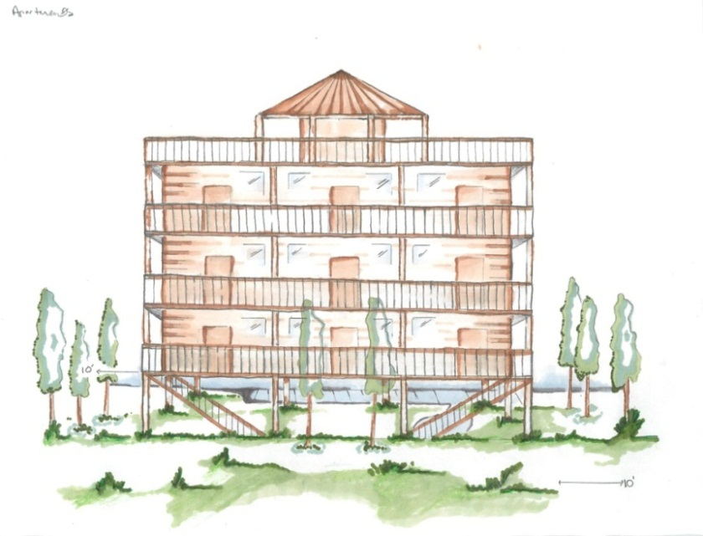
RSF Activation and Deployment
RSFs are activated in order to:
Identify recovery challenges in collaboration with the state/tribe.
Strategize on how their capabilities, resources and authorities can be applied to those challenges.
Take action to support the state and local communities in addressing those challenges.

Slide 28
RSF Activation/ Deployment
FDRC notifies relevant RSF National Coordinator of the RSF activation
RSF National Coordinator will identify and notify the corresponding primary/support agency representatives of activation
Deployed as needed via MA, IAA, other authority

Slide 29
Mission Scoping Assessment
Overview

Slide 30
What is the MSA?
The MSA is an early (snapshot) evaluation by the RSFs of the current and anticipated impacts of the disaster and identification of recovery issues and needs that may hinder an effective recovery.
The issues and needs identified by the MSA serve as the foundation for the development of the RSS.

Slide 31
How is the MSA Conducted?
The RSFs consolidate all available data and assessment reports to create a picture of the disaster damage and the best available understanding of the current and anticipated recovery support needs and issues.

Slide 32
The MSA process is not tied to how specific recovery issues may be addressed or resolved.
RSF strategic objectives and recovery support actions are developed later
in the RSS process.

Slide 33
What Kind of Information Does the
MSA Process Capture?
Current and anticipated issues and needs which may not be addressed by traditional Federal programs.
Specific jurisdictions that may require enhanced Federal recovery support.
Any area-wide or overarching, multi-sector recovery issues.
Potential opportunities for improving sustainability and resiliency against future disasters.

Slide 34
MSA Executive Summary Outline
Background and Current Situation
Methodology
Description of the data collection and analysis process that the RSFs followed in their (quick-glance) assessment.
RSF Findings
Outlines recovery issues and needs that the assessment revealed, and the potential implications of such findings.
Resources (Optional)
May feature the local and governmental capacity and other resiliency indicators that characterize the State/Tribal and local ability to address their recovery issues.

Slide 35
FDRC/RSF Mission Scoping
INITIAL SCOPING OF NEEDS PHASE
5 – 14 days after becoming mission ready
MSA & RSS DEVELOPMENT PHASE
1 – 3 months after determining need for FDRC
IMPLEMENTATION PHASE
3 months to 5 years after completing the RSS
RSF National Coordinators Maintain Situational Awareness of Potential Recovery Concerns
FCO or RA Activates Advance Evaluation Team (AET)
Advance Team Recommend Support
FDRC & RSF support is warranted; FDRC
& relevant RSFs are activated
Yes
No
No FDRC or RSF Recovery Support Warranted
FDRC Activates RSFs
RSFs remotely provide & monitor need for recovery support
No
RSS Update Loop
Yes
RSF Appoints Field Coordinator
Mission Scoping Identifies level of effort necessary to initiate recovery support
Development of Recovery Support Strategy (RSS)
Kickoff & Implement RSS
Track, Monitor & Deliver Assistance
Transition & Return to Steady-State
Mission Scoping Initiated
STATE/TRIBAL/LOCAL COORDINATION & INVOLVEMENT

Slide 36
Recovery Support Strategy
Overview

Slide 37
What is the Recovery Support Strategy (RSS)?
The RSS outlines how RSF departments and agencies support the recovery efforts of state/tribal and local governments.
The RSS serves as a way to communicate federal recovery support strategies to recovery partners.
The RSS serves as a problem-solving platform that helps to integrate, organize, sequence, and manage RSF support actions and resources.
The RSS is not a state or local recovery plan.

Slide 38
Why Do We Need a Recovery Support Strategy?
Harmonize and sequence recovery activities
Guide RSF operations
Communicate to stakeholders how the RSFs will support recovery efforts
Track recovery progress
Evaluate adequacy and pace of recovery assistance

Slide 39
Development of the RSS is NOT the Objective of the Mission
The objective of the FDRC and RSFs is to support state/tribal and local community recovery goals in a coordinated manner.
The development of the RSS should not delay recovery support actions of the RSFs.
RSFs should develop recovery support actions to contribute to ongoing recovery efforts on the state/tribal and local levels.

Slide 40
Who Develops the RSS?
The FDRC oversees development of the RSS.
RSS development is a collaborative process that requires focused engagement by the activated RSF agencies and departments.
The FDRC uses the Federal Disaster Recovery Officer (FDRO), and National Disaster Recovery Support Cadre staff to assist with RSS development .

Slide 41
What Should the RSS Tell Us?
Describes the current and anticipated recovery issues and challenges.
Identifies the RSFs’ strategic objectives and outlines the support actions that the RSFs will undertake to achieve those objectives.
Helps to inform stakeholders of the RSF’s capabilities and how they plan to support their recovery efforts.
Provides a broad time-frame for completing the recovery support by identifying deliverables and support milestones.

Slide 42
Who is the Audience of the RSS?
Primary Audience:
Federal Disaster Recovery Coordinator
Leadership of RSF Agencies and Departments
Federal Coordinating Officer
FEMA Regional Administrator
Secondary Audience:
State/Tribal Disaster Recovery Coordinator
State Coordinating Officer
State Recovery Officials
National Task-Forces

Slide 43
RSS Development
Having identified the recovery issues and needs through the Mission Scoping Assessment, the RSS development will focus on guiding RSF Field Coordinators through the RSS development process :
RSFs identify their Strategic Objective(s)
RSFs outline Recovery Support Actions
RSFs identify Recovery Metrics
RSFs identify Implementation Milestones

Slide 44
Identify Strategic Objectives:
Based on disaster issues identified in the Mission Scoping Assessment.
Crafted in support of the state/tribal and local recovery goals.
Framed in the context of providing support rather than achieving a recovery goal.
Strategic objectives should be attainable and based on RSF
authorities, capabilities and resources

Slide 45
RSF Strategic Objective
ECONOMIC: Support the State/local governments in recovering the tourism economy.
HOUSING: Assist the State with stabilizing available housing stock and provide communities with the tools to help them meet the need for quality affordable rental homes.
CPCB: Provide training to municipalities to build planning capacity, provide direct planning support to communities who have experienced that lack the capacity to lead and implement a successful recovery process.

Slide 46
RSF Work Sessions to Identify Recovery Support Activities/actions
RSF Recovery Strategic Objectives tell us where the RSFs want to go; and RSF Support Activities
tell us how to get there.

Slide 47
Economic RSF
Issue:
Effect on Tourism – All Shore communities have been negatively impacted by a misperception that the entire shore is “closed for business”.
Strategic Objective(s):
Support the State/local governments in recovering the tourism economy.

Slide 48
Economic RSF
Support Actions:
Support the establishment of Tourism Issues Working Group with state and federal partners to support implementation of a marketing campaign to revitalize the affected areas.
Organize a Peer-to-Peer Tourism Symposium with subject matter experts in disaster-recovery-related tourism initiatives.
Facilitate ten “Access to Capital” forums over the next six months to provide information about funding options for tourism-related businesses in the areas.

Slide 49
Housing RSF
Issue:
Insufficiency of affordable permanent housing stock to accommodate displaced households.
Strategic Objective(s):
Assist the State with stabilizing available housing stock and provide communities with the tools to help them meet the need for quality affordable rental homes.

Slide 50
Housing RSF
Support Actions:
Support the State Led Disaster Housing Task Force in their construction and rehabilitation of affordable, sustainable housing in the impacted areas
Facilitate a Federal Partners Meeting with supporting agencies to address the financial ability of households to secure, repair, and/or rebuild permanent housing
Conduct outreach and help kick-off a public messaging campaign to promote use of IRS tax rules available to individuals affected by the disaster.

Slide 51
Identify Recovery Metrics:
RSF Recovery Metrics enable the FDRC
to measure progress towards completion of support actions and tasks that are linked to
RSF strategic objectives.

Slide 52
RSF Recovery Metrics
Recovery Metrics can be used to measure, monitor and demonstrate progress and value of recovery support actions.
Complex RSF objectives with multiple tasks may require multiple measures of performance.
Performance metrics can employ tables, charts and graphs to demonstrate progress toward the stated RSF objectives
.

Slide 53
RSS Implementation Phase
INITIAL SCOPING OF NEEDS PHASE
5 – 14 days after becoming mission ready
MSA & RSS DEVELOPMENT PHASE
1 – 3 months after determining need for FDRC
IMPLEMENTATION PHASE
3 months to 5 years after completing the RSS
RSF National Coordinators Maintain Situational Awareness of Potential Recovery Concerns
FCO or RA Activates Advance Evaluation Team (AET)
Advance Team Recommend Support
FDRC & RSF support is warranted; FDRC
& relevant RSFs are activated
Yes
No
No FDRC or RSF Recovery Support Warranted
FDRC Activates RSFs
RSFs remotely provide & monitor need for recovery support
No
RSS Update Loop
Yes
RSF Appoints Field Coordinator
Mission Scoping Identifies level of effort necessary to initiate recovery support
Development of Recovery Support Strategy (RSS)
Kickoff & Implement RSS
Track, Monitor & Deliver Assistance
Transition & Return to Steady-State
Mission Scoping Initiated
STATE/TRIBAL/LOCAL COORDINATION & INVOLVEMENT

Slide 54
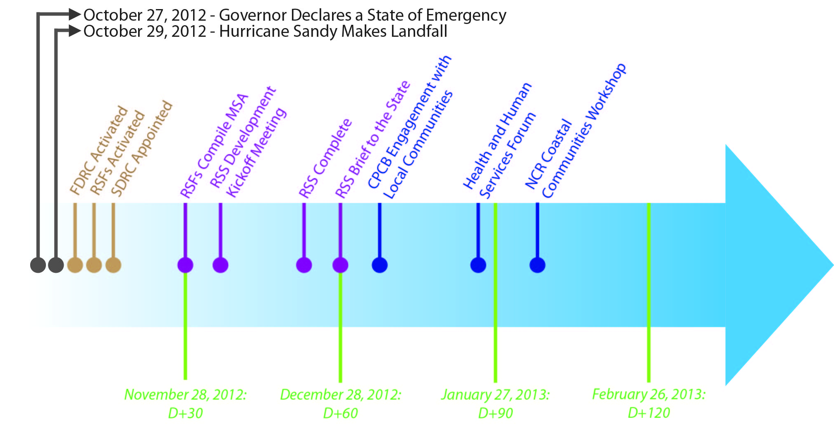
Implementation Timeline/Key Milestones

Slide 55
Questions?
Michelle Diamond
Community Planning & Capacity Building Coordinator
michelle.diamond@fema.dhs.gov
215.931.5568

